Slide 1
Optic Fiber
Ryan Bibby and Jaden Allen

Slide 2
What Is Optic Fiber
Optic Fiber (Also Fibre) is a highly transparent tube surrounded by a very reflective material, on one end the a light turns on and off very fast representing 1’s and 0’s on the other end there is a light sensor which transfers it to an electrical signal, that the computer uses as information.

Slide 3
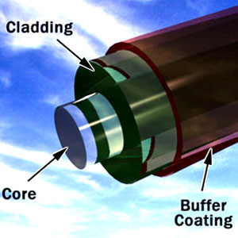
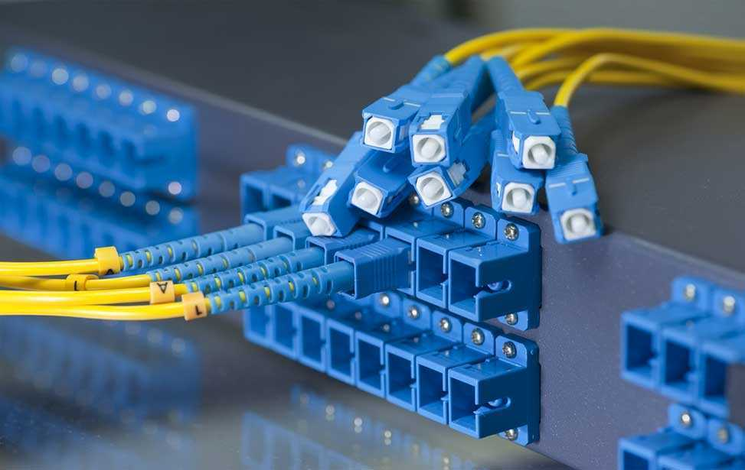
Invented
Optic fiber invented in 1854 by John Tyndall. But started becoming popular in the 1940’s for medical purposes and 2000’s for data transfer.

Slide 4
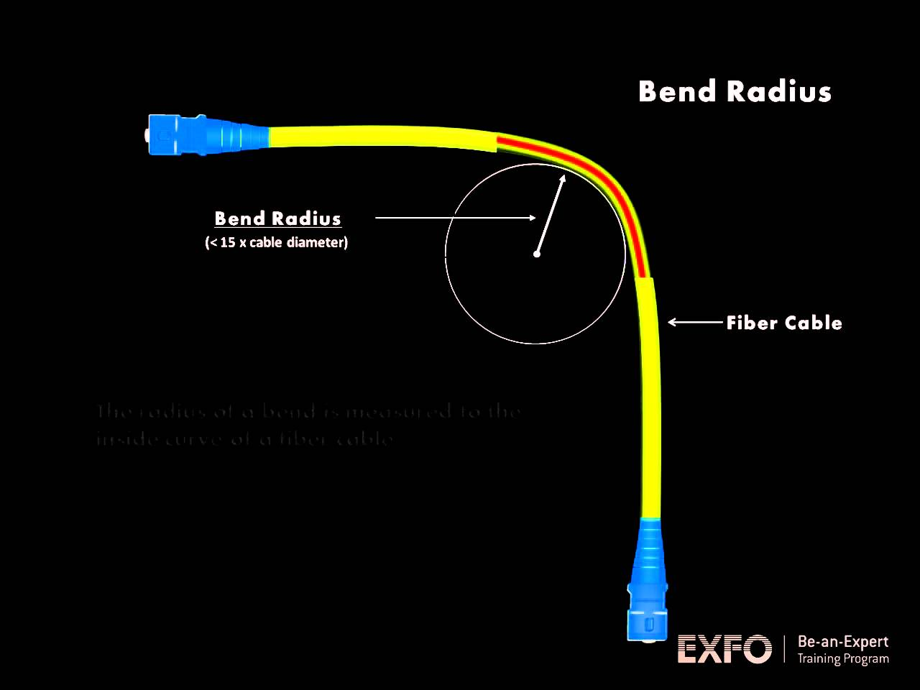
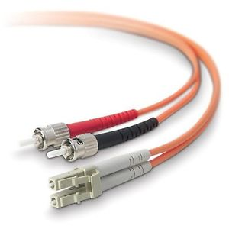
What need issue was addressed?
It was used to prove to the royal academy light could be bent.

Slide 5
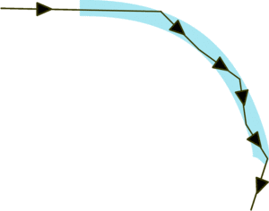
Who Invented it?
It was invented by John Tyndall in 1854 he used a curved stream of water.

Slide 6

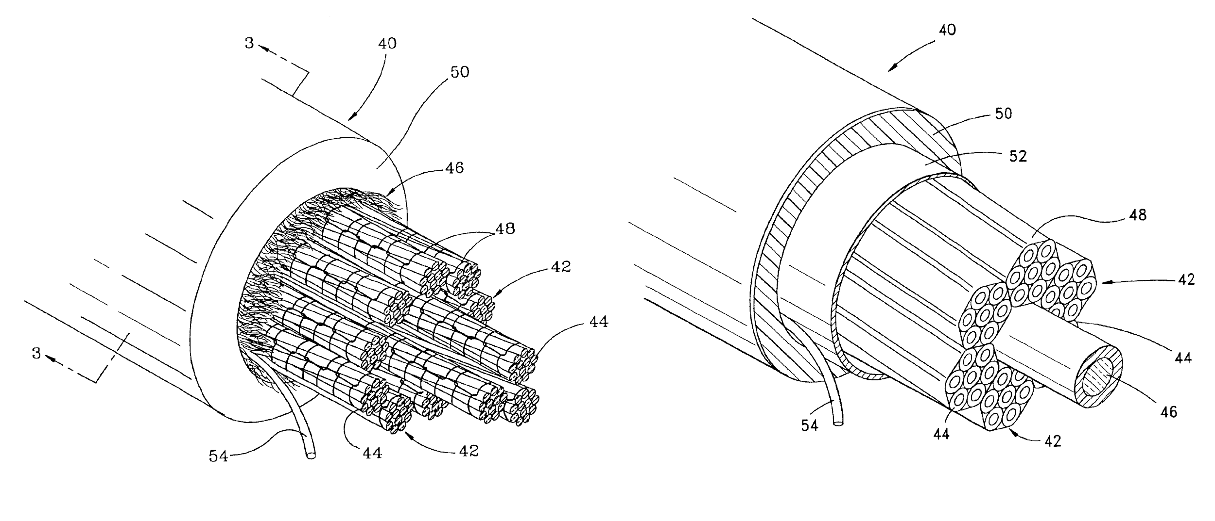
Patents
Optic Fiber is currently patented by

Slide 7

Original materials
The original materials where a cement tube and water.

Slide 8
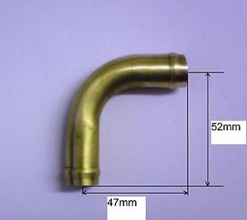
Originally made?
It was originally made with water in a cement tube bending 90° they put a candle at one end and looked at the other end, when they saw the light they knew light could bend.

Slide 9
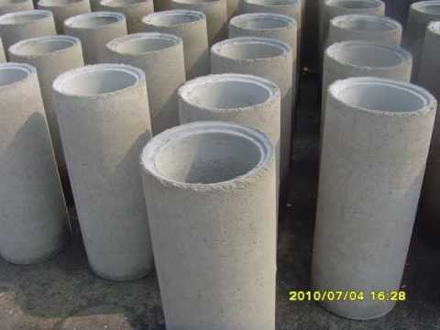
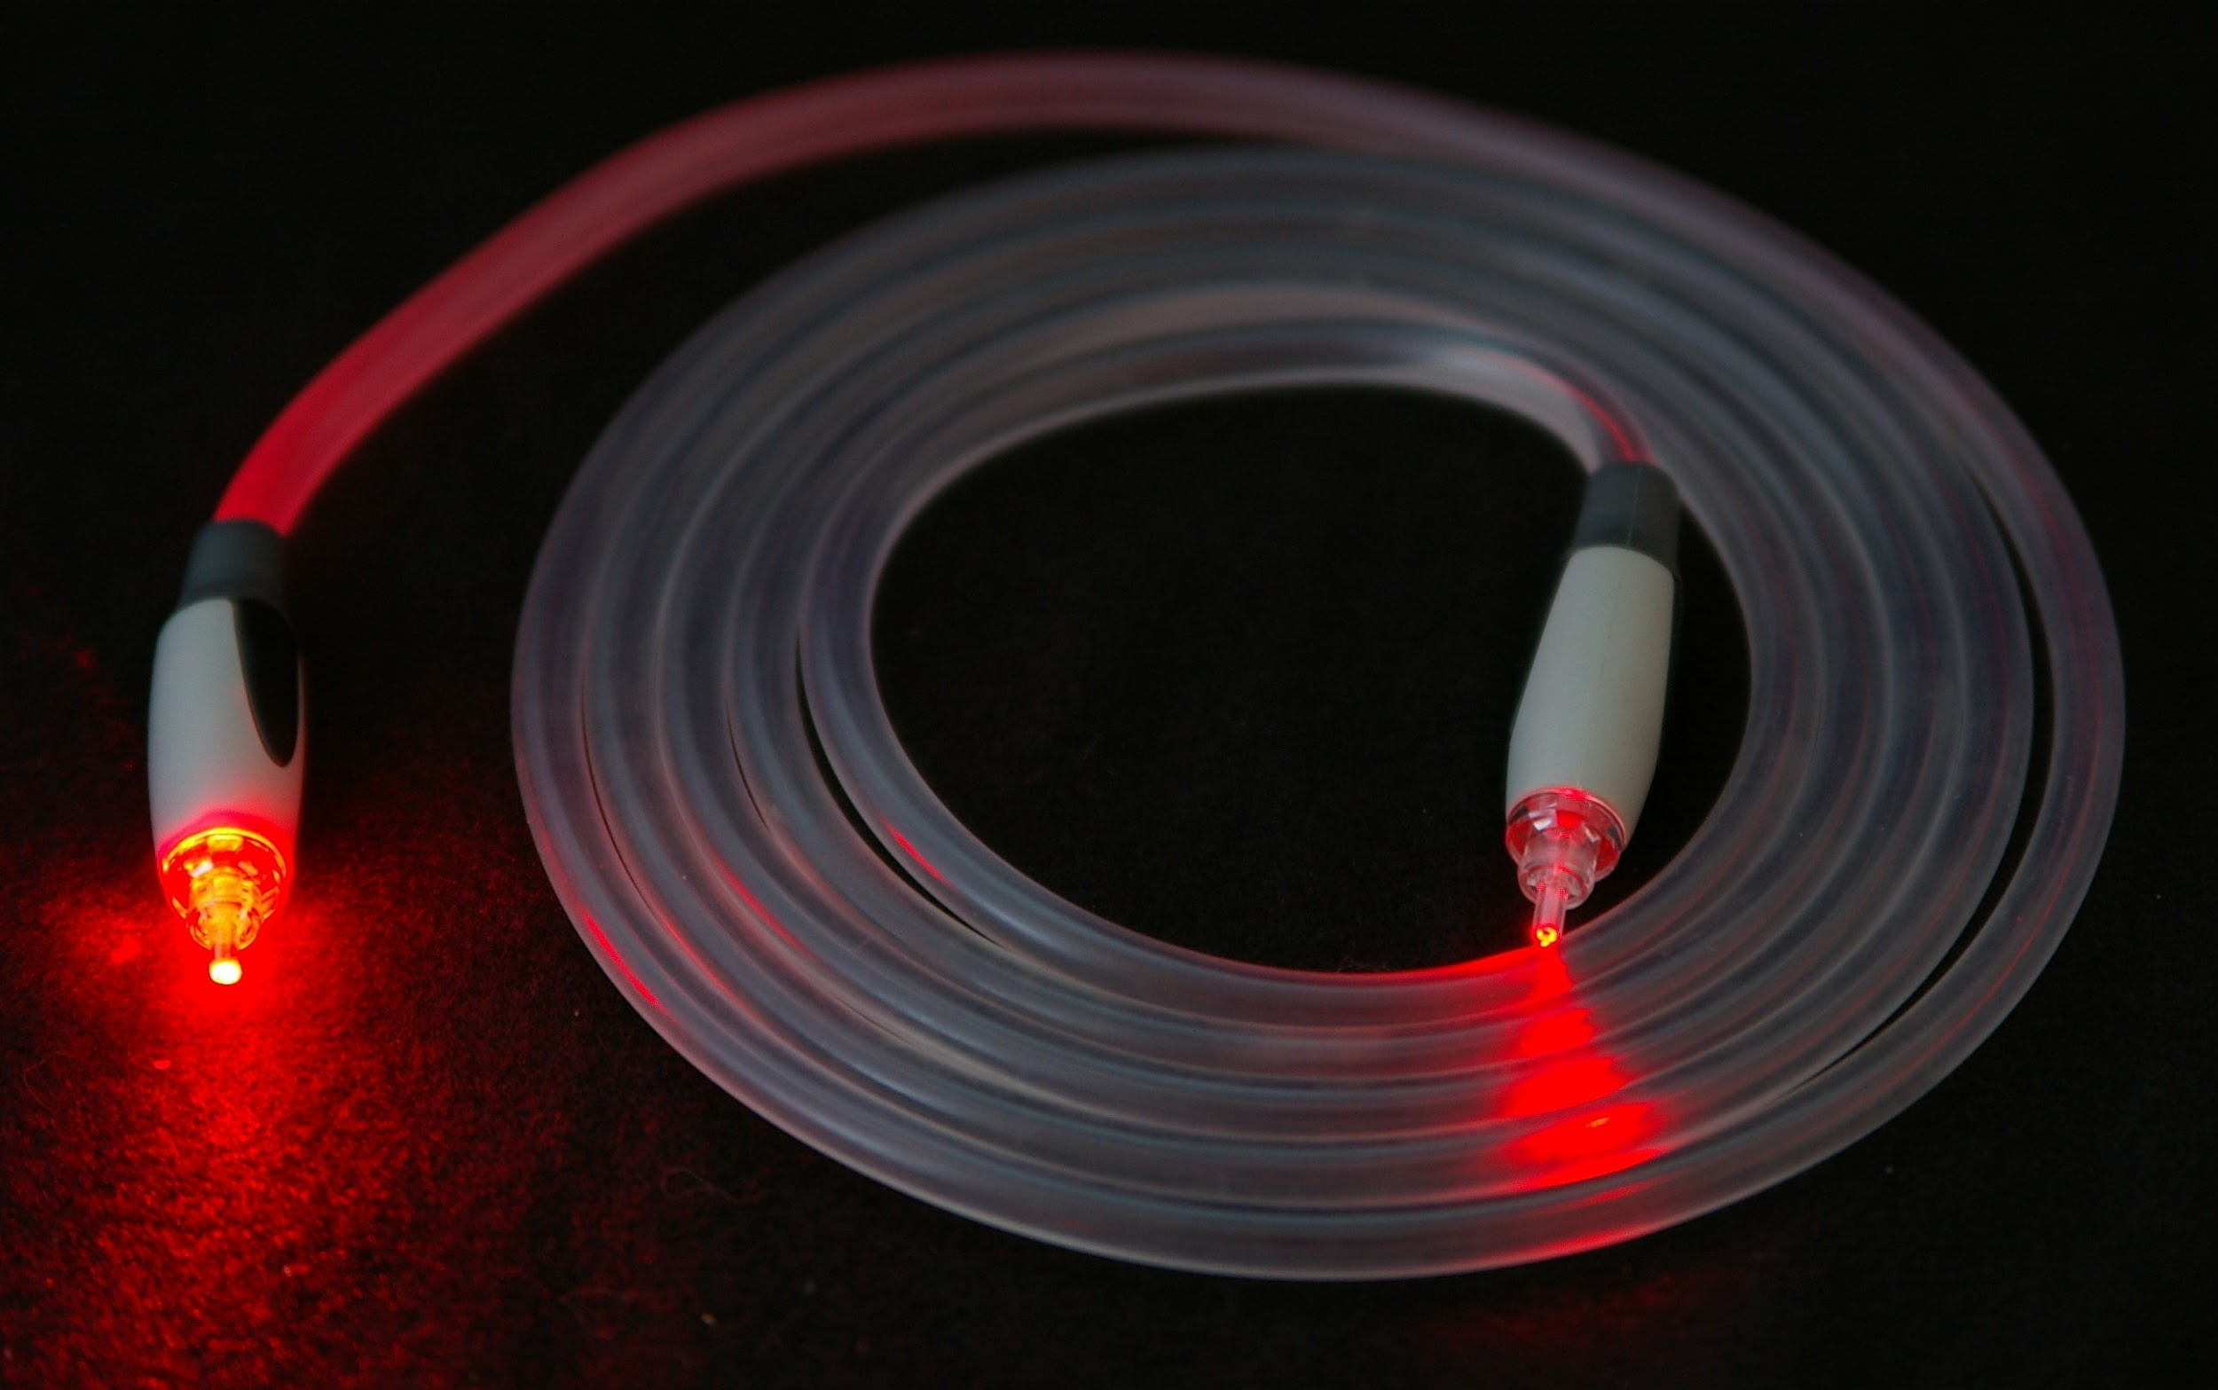
Improvements
Now instead of water and cement they are glass and polymers. Some of the cheaper ones use a plastic polymer instead of glass.

Slide 10
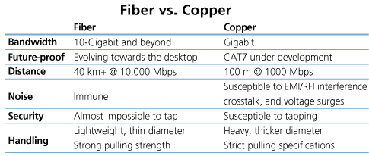
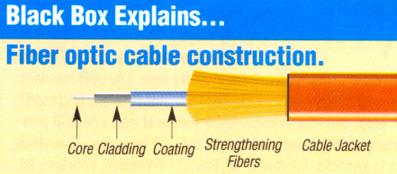
Why improvements?
It can carry signals longer distances without any interference that copper cables get.

Slide 11

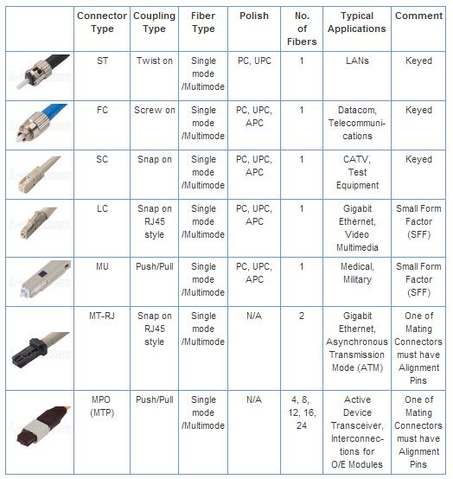
Who uses it?
A Lot of people use it everyday without knowing it. People use it for internet, phone, tv and many other amazing ways.

Slide 12
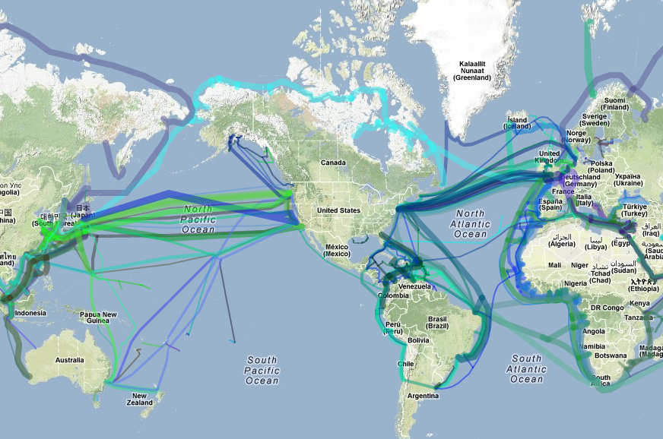
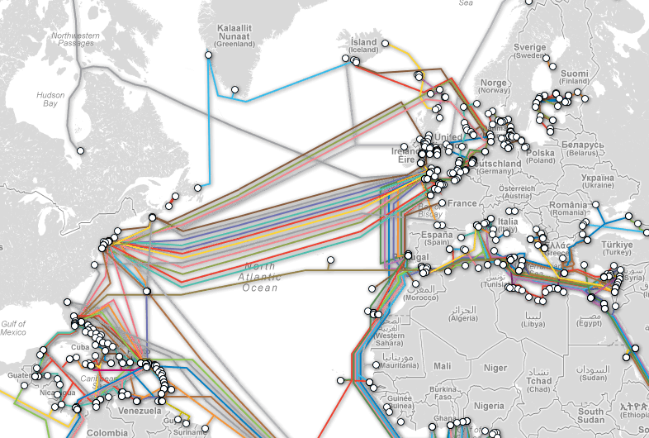
Impact?
This has helped connect the world before it was almost impossible to get a signal agroo the ocean with copper wires; due to signal loss interference and if the wire gets cut all all it won't work, and it's nearly impossible to find the little hole. But in optic fiber cables there is no interference and little to no signal loss and if there is a little cut in the wire it will still work, but not a reliable and it is easy to find because it is glowing.
OLD
NEW

Slide 13
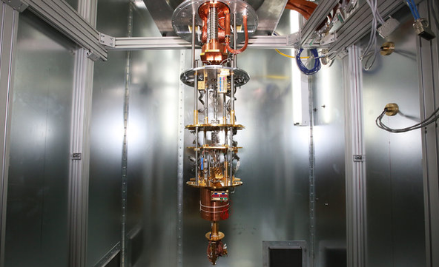
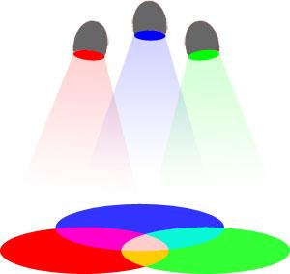
If I could change it.
Right now it only uses red light, I would have it use green and blue so it can carry more than 0’s and 1’s for in the future, for example quantum computing.

Slide 14

https://www.youtube.com/watch?v=_Bw2NFBDxR8
http://computer.howstuffworks.com/fiber-optic.htm

